Slide 1
Loops
Presented by Manal Asghar

Slide 2
Do-While loop
The do while loop is a variant of the while loop. This loop will execute the code block once, before checking if the condition is true, then it will repeat the loop as long as the condition is true.
The do while runs at least once, even if the condition is false from the start.
This is because the code block is executed before the condition is tested:

Slide 3
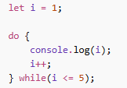
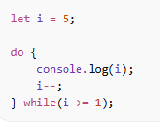
Practice
Print Numbers 1 to 5
Countdown 5 to 1

Slide 4
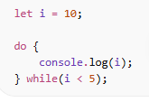
Do-while loop
This condition is false but it will run first time

Slide 5
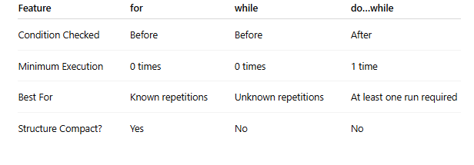
Difference Between for, while and do-while Loops

Slide 6
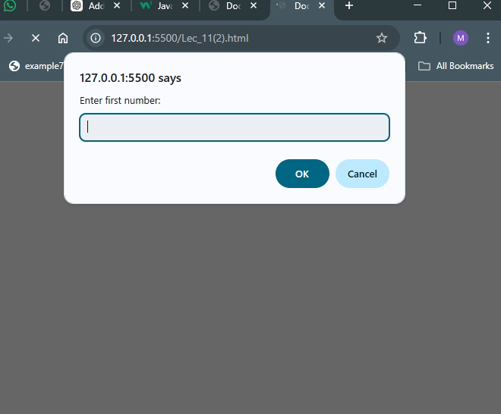
Calculator with Loops and Conditions

Slide 7
Array
An Array is an object type designed for storing data collections.
Key characteristics of JavaScript arrays are
Elements: An array is a list of values, known as elements.
Ordered: Array elements are ordered based on their index.
Zero indexed: The first element is at index 0, the second at index 1, and so on.
Dynamic size: Arrays can grow or shrink as elements are added or removed.
Heterogeneous: Arrays can store elements of different data types (numbers, strings, objects and other arrays).

Slide 8
Why Use Arrays?
If you have a list of items (a list of car names, for example), storing the names in single variables could look like this:
let car1 = "Saab"; let car2 = "Volvo"; let car3 = "BMW";
However, what if you want to loop through the cars and find a specific one? And what if you had not 3 cars, but 300?
The solution is an array!
const cars = ["Saab", "Volvo", "BMW"];

Slide 9
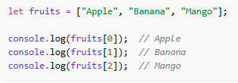
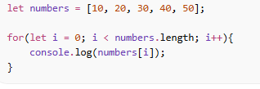
Basic 1D Array
Index always start from 0.
Looping through 1D array (For loop)

Slide 10
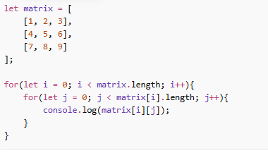
2D Array (Two-Dimensional Array)
Array inside another array
Like a table (rows & columns)

Slide 11
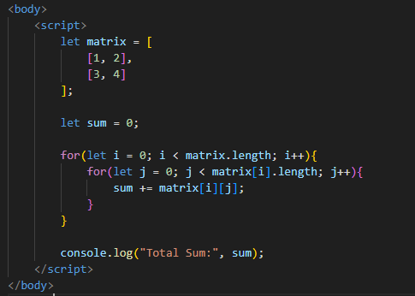
Sum of All Elements (2D Array)

Slide 12
Functions
Functions are Code Blocks
Functions are reusable code blocks designed to perform a particular task.
Functions are executed when they are called or invoked.
Functions are fundamental in all programming languages.

Slide 13
Why Use Functions?
Functions help you to:
Reuse code (write once, run many times)
Organize code into smaller parts
Make code easier to read and maintain
What Does a Function Look Like?
A function can be created with the function keyword, a name, and parentheses.
The code to run is written inside curly brackets.

Slide 14
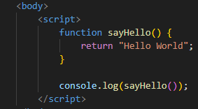
Functions in JavaScript
The function below returns the text "Hello World".
But it will not run before you call it.
Calls the function But it does not use the result.
When a function returns a value, you can store the value in a variable.
You can display the returned value in many ways, for example using console.log() or HTML.

Slide 15
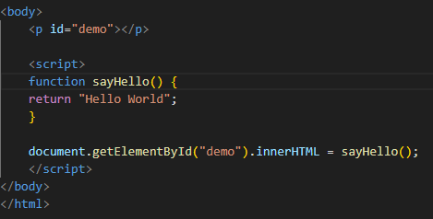
Practice

Slide 16
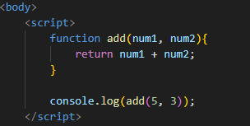
Function with Parameters and Arguments
Parameter: Parameter are input values

Slide 17
Return Statement

Slide 18
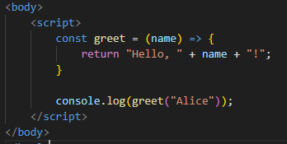
Arrow Function
It does not use the function keyword.
It uses the => (arrow) operator instead
Curly brackets {} are optional for single-line expressions.
The return keyword is not required for single-line expressions.
It allows writing functions in a more concise and compact way.
It reduces boilerplate code.
It makes simple functions cleaner and easier to read

Slide 19
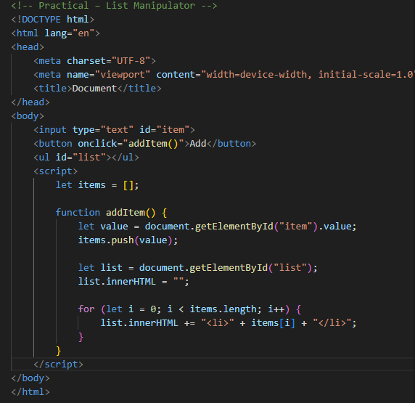
Practical – List Manipulator

Slide 20
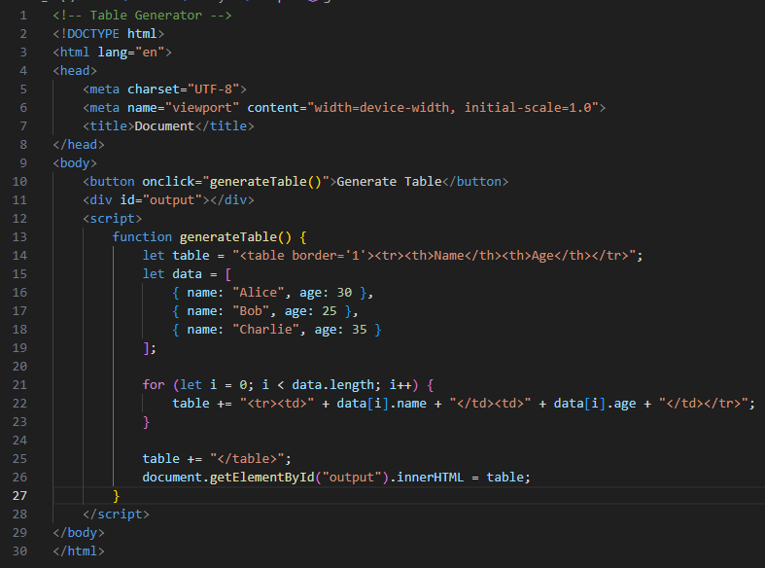
Table Generator

